Slide 1
MODFLOW 6—Transport and Variable-Density Flow
Introduction to Groundwater Modeling using MODFLOW

Slide 2
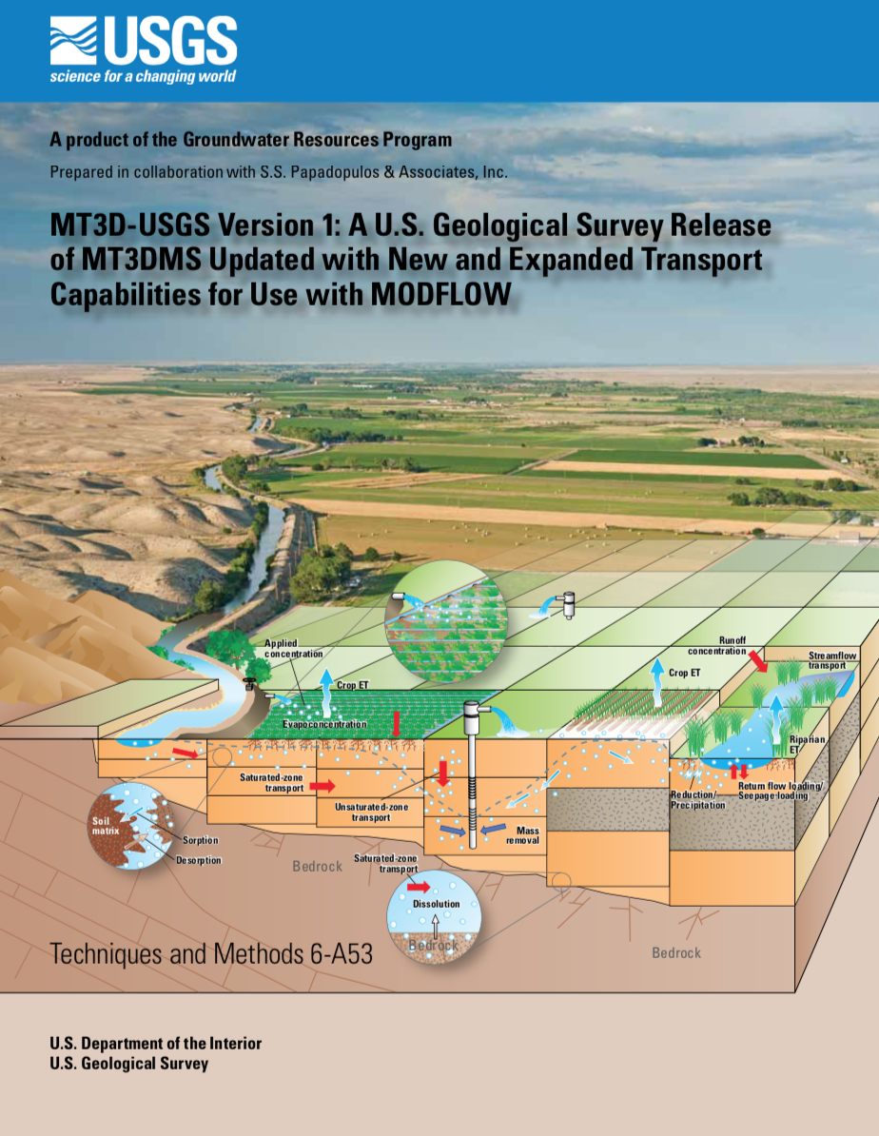
MODFLOW 6 GWF + MT3D-USGS
MT3D-USGS developed and maintained in cooperation with S.S. Papadopulos & Associates Inc.
Works with standard head and budget files produced by MODFLOW 6
Regular MODFLOW grids
Notes:
Many of you are probably familiar with MT3D-USGS, which is a collaborative effort between SSPA and the USGS
I’ve been using MT3D for about 30 years, and I think it’s a great program. In my earlier life I worked with Weixing Guo to couple MT3D and MODFLOW to create SEAWAT.
The purpose of this slide is to let you know that MT3D-USGS works with the output from MODFLOW 6 (for a regular grid and a couple other restrictions).
We’ve had a fair number of compatibility problems over the years with the Flow-Transport-Link File (though they should mostly be fixed now)
Our approach here was to have MT3D-USGS work directly with the output files from MODFLOW 6 rather than writing a separate FTL file.

Slide 3
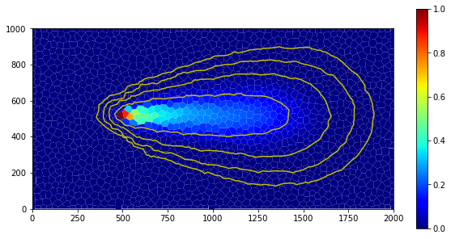
Groundwater transport (GWT) Model

Slide 4

MODFLOW 6 Groundwater Transport Model
First released October 2020
New model type in MODFLOW 6
Developed in collaboration with Sorab Panday, GSI Environmental Inc.
Patterned after MT3D, USG-Transport, MODFLOW-GWT, SUTRA
Notes:
What kind of modeler would I be if I didn’t put in an a partial differential equation…

Slide 5
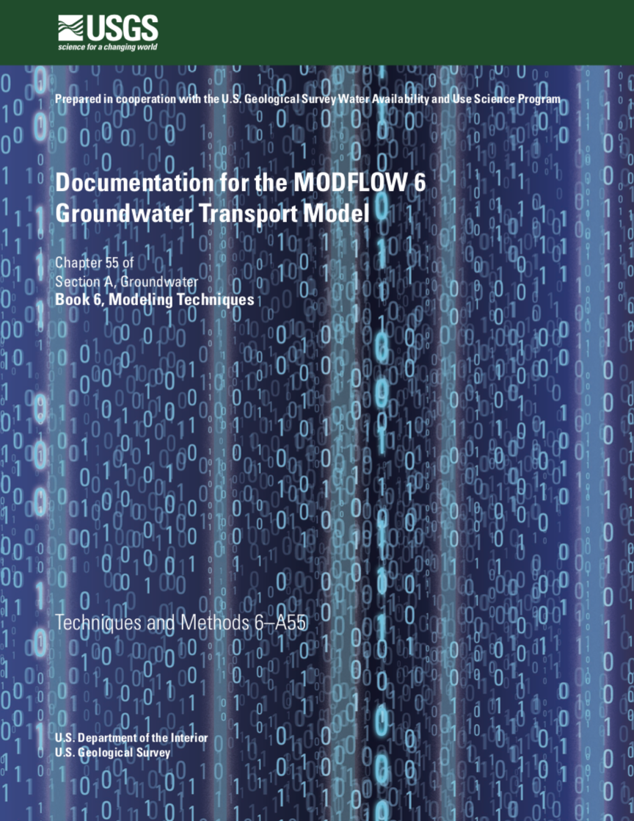
GWT Model Status
Available now in MODFLOW 6
Fully supported in FloPy
Theory report published
Represents a single species, BUT, can have any number of GWT Models
Transport across grids (new in 6.3.0)

Slide 6
Groundwater Transport (GWT) Model
Mobile Domain
Immobile Domain
Discretization (DIS, DISV, DISU)
Advection (ADV)
Source and Sink Mixing (SSM)
Mobile Storage and Transfer (MST)
Streamflow Transport (SFT)
Immobile Storage and Transfer (IST)
Immobile Storage and Transfer (IST)
Immobile Storage and Transfer (IST)
Initial Conditions (IC)
Dispersion (DSP)
Mass Source Loading (SRC)
Lake Transport (LKT)
Output Control (OC)
Constant Concentration (CNC)
Multi-Aquifer Well Transport (MWT)
Observations (OBS)
Unsaturated Zone Transport (UZT)
Flow Model Interface (FMI)
Mover Transport
(MVT)
Data Input
Transport/
Grid
Transport/
External
Transport/
Internal
Transport/
Advanced Package
Transport/
Internal
Transport/
Internal
Transport/
Internal

Slide 7
MODFLOW 6 GWF and GWT Approach (Option 1: Separate Simulations)
Head File
Simulation 1
MODFLOW 6 GWF
Budget File
Simulation 2
MODFLOW 6 GWT
Concentration File(s)
Can use different time-step lengths for GWT Model

Slide 8
MODFLOW 6 GWF and GWT Approach (Option 2: Coupled Simulation)
Head File
Simulation
MODFLOW 6 GWF/GWT
Budget File
Concentration File(s)
Must use same time-step lengths for both models

Slide 9
Variable-density simulations

Slide 10
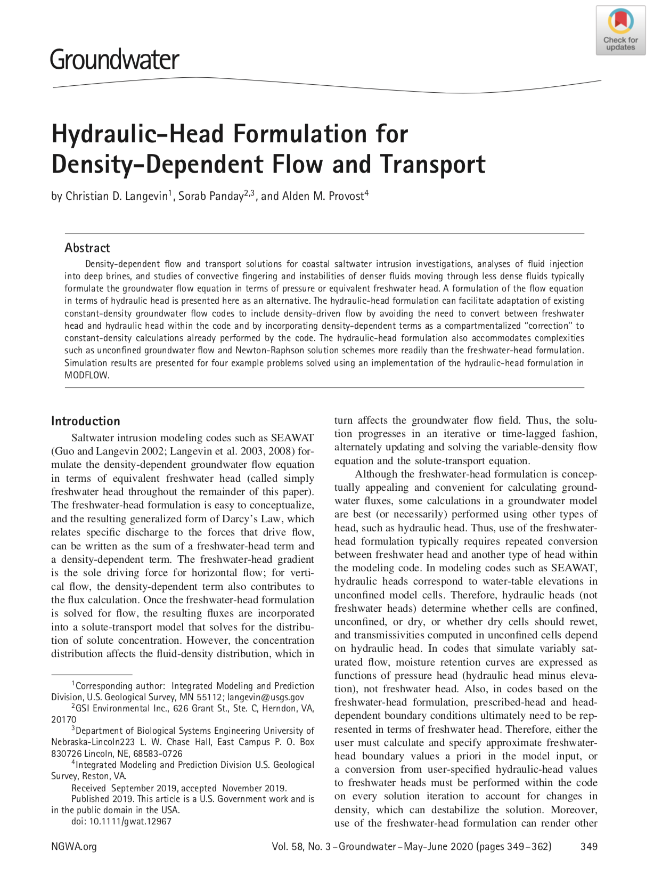
Coupled Variable-Density Flow and Transport
SEAWAT capabilities now available in MODFLOW 6
Coupled variable-density flow and transport
Density can be a function of one or more solute concentrations
Bonus!
Flexible unstructured meshes
Newton-Raphson formulation
Notes:
Provides SEAWAT capabilities plus much more (Newton, unstructured grid, advanced packages, …)

Slide 11
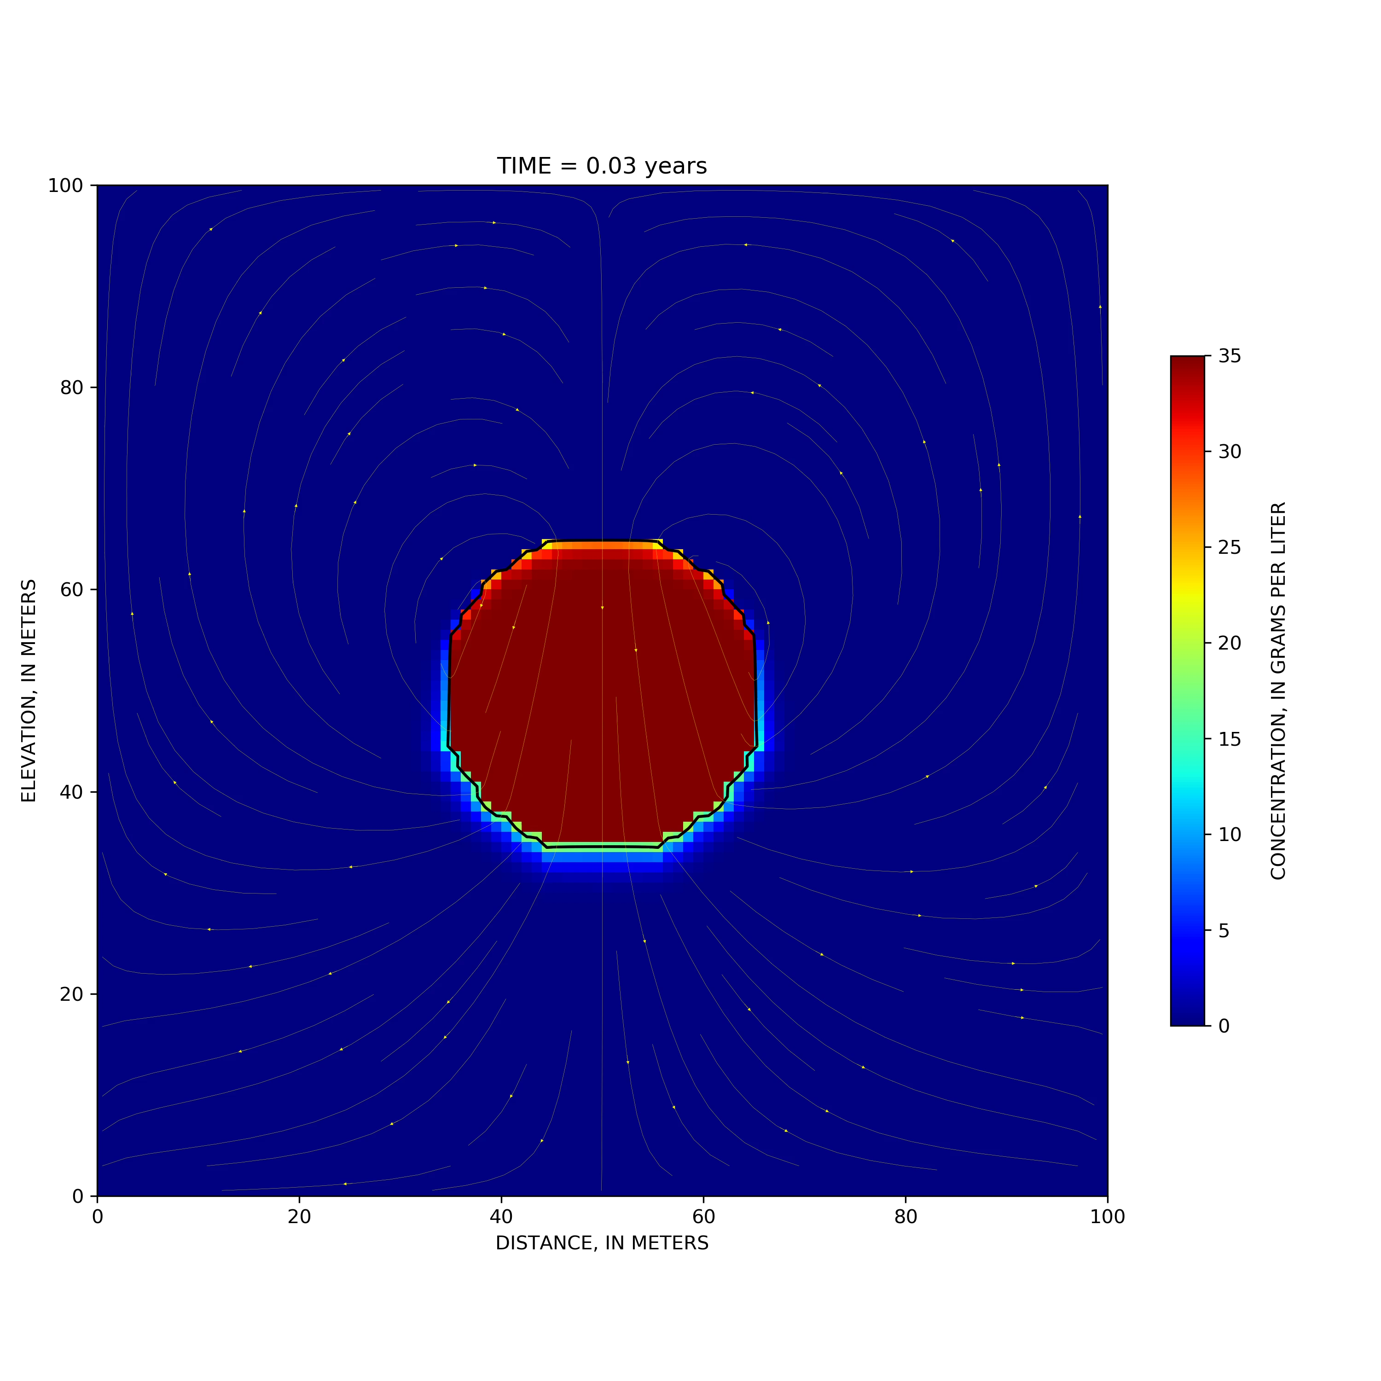
Coupled Variable-Density Flow and Transport
Run GWF and GWT in same simulation
Turn on Buoyancy Package in GWF Model
Represent salt as a chemical species
Notes:
Provides SEAWAT capabilities plus much more (Newton, unstructured grid, advanced packages, …)

Slide 12
examples

Slide 13
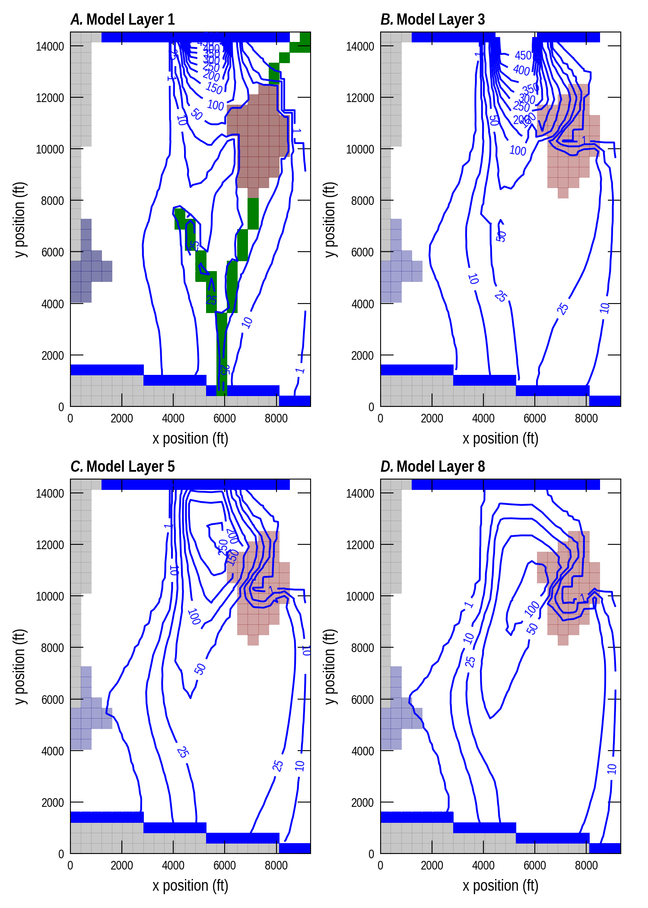
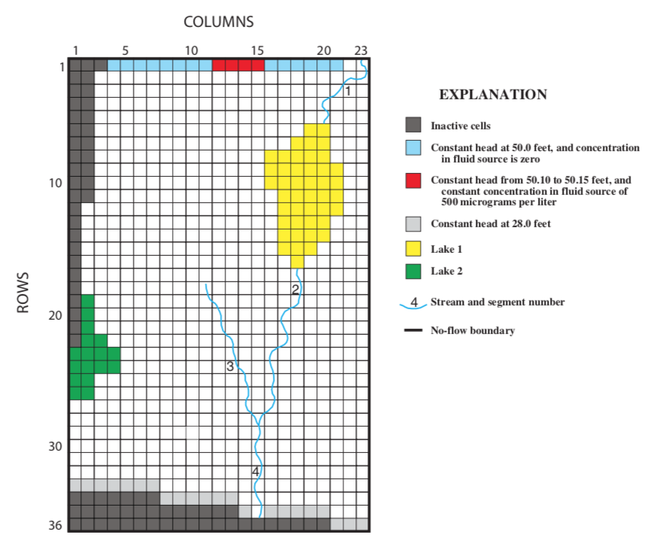
Advanced Packages and Water Mover
Notes:
Concentrations after 25 years

Slide 14
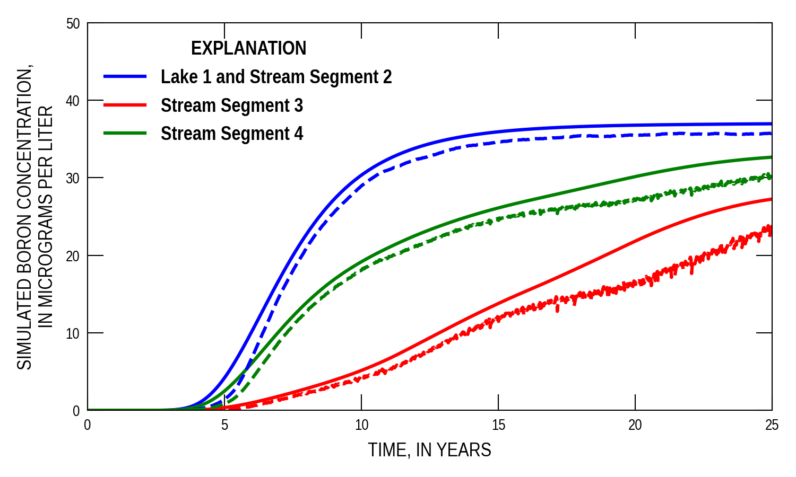
Surface and Groundwater Flow and Transport
Comparison between MODFLOW 6 (solid lines) and GWT (dashed lines)
Notes:
Concentrations after 25 years

Slide 15
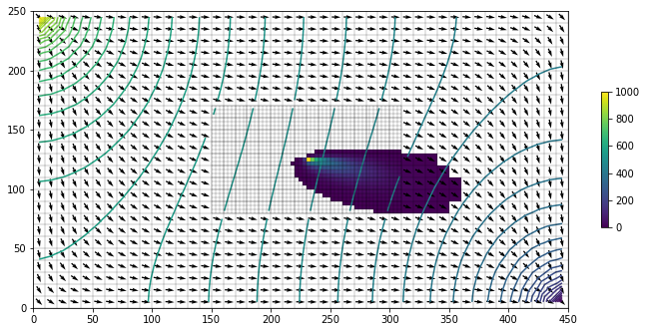
Transport and Local Grid Refinement

Slide 16
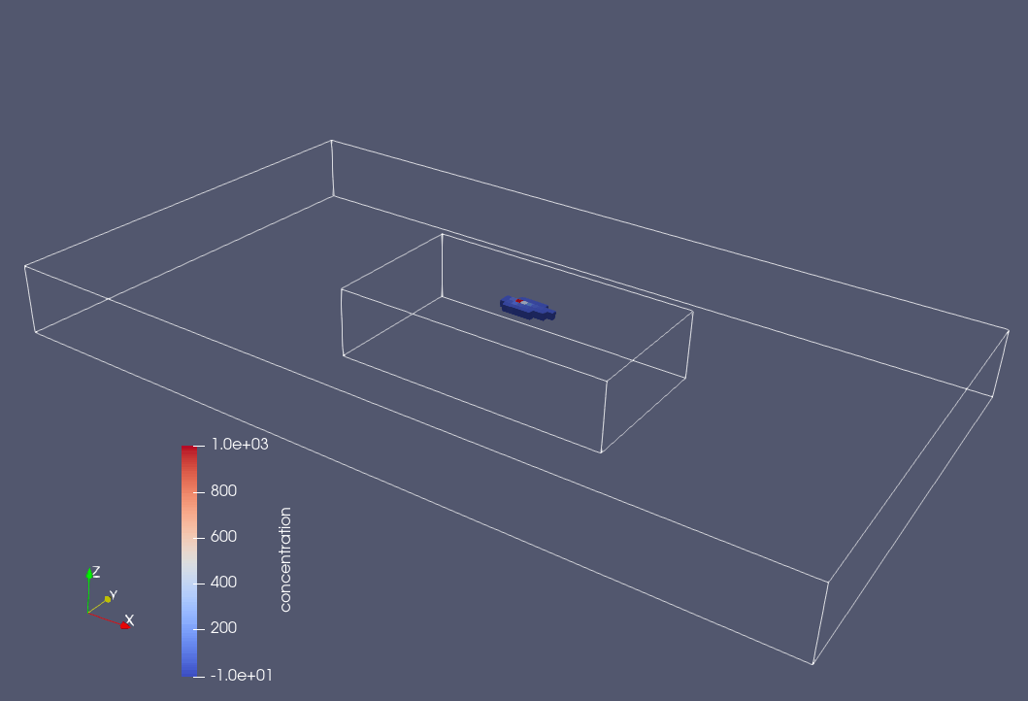

Slide 17
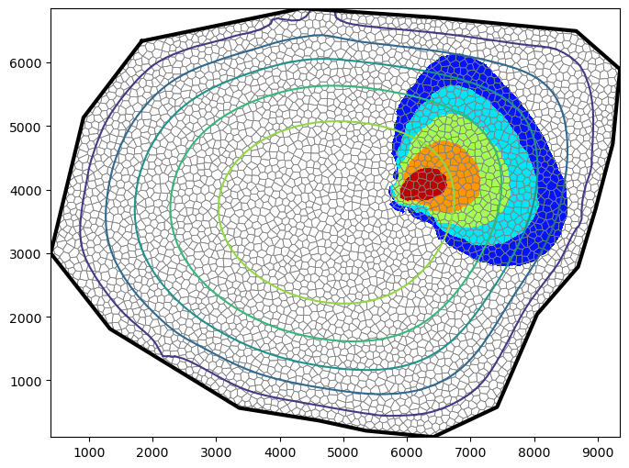
Solute Transport Example
Use flow model from example 4
Introduce contaminant source at location (x, y) = (6000, 4000)
Simulate 100 years of contaminant migration
Visualize results
Notes:
Let’s try building and running a MODFLOW 6 solute transport model. For this example, we will use the results from the flow model with the Voronoi grid as input to the solute transport model. The solute transport model is simple and has a constant contaminant concentration of 100. We will simulate the formation and movement of a solute plume over a 100-year period.

Slide 18
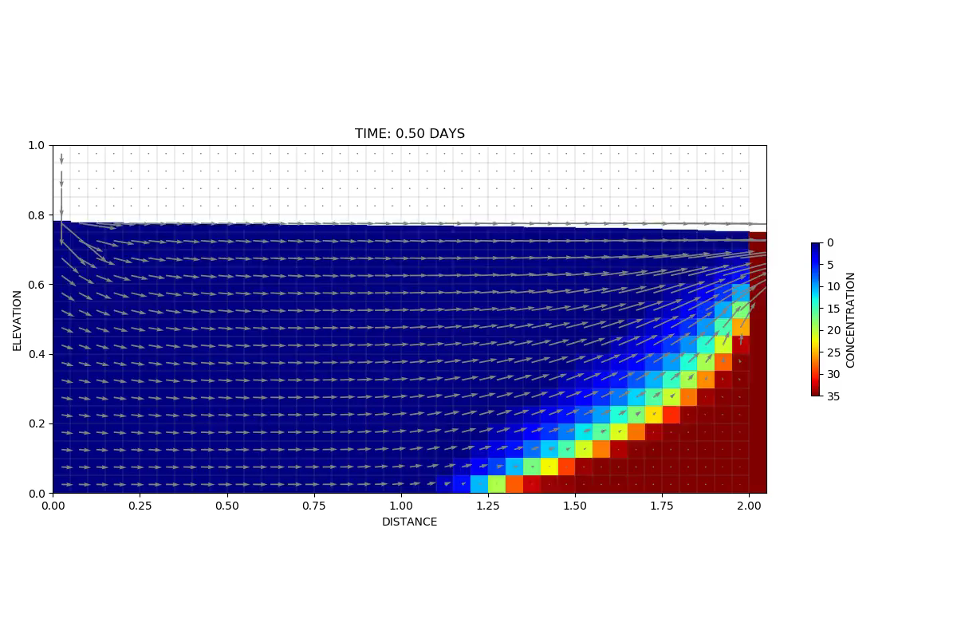
Coupled Flow and Transport Capabilities

Slide 19
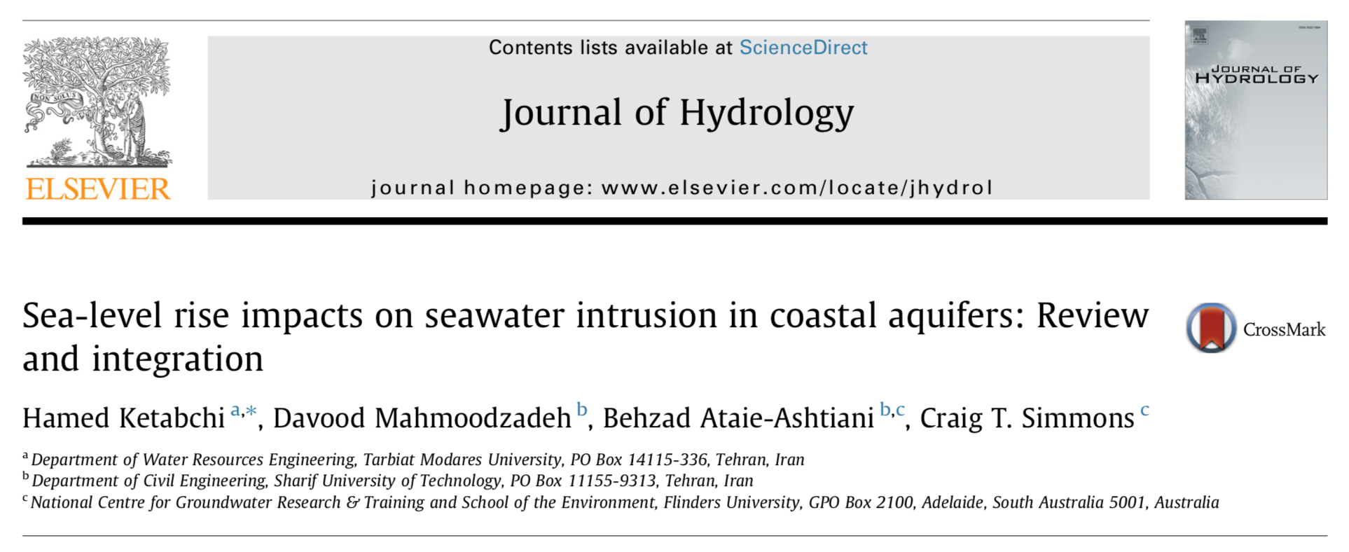
Coastal Aquifer Simulation
recharge
freshwater inflow
ocean boundary
no flow

Slide 20
Spin-Up Boundary Conditions
recharge
recharge
recharge
recharge
general-head boundary

Slide 21
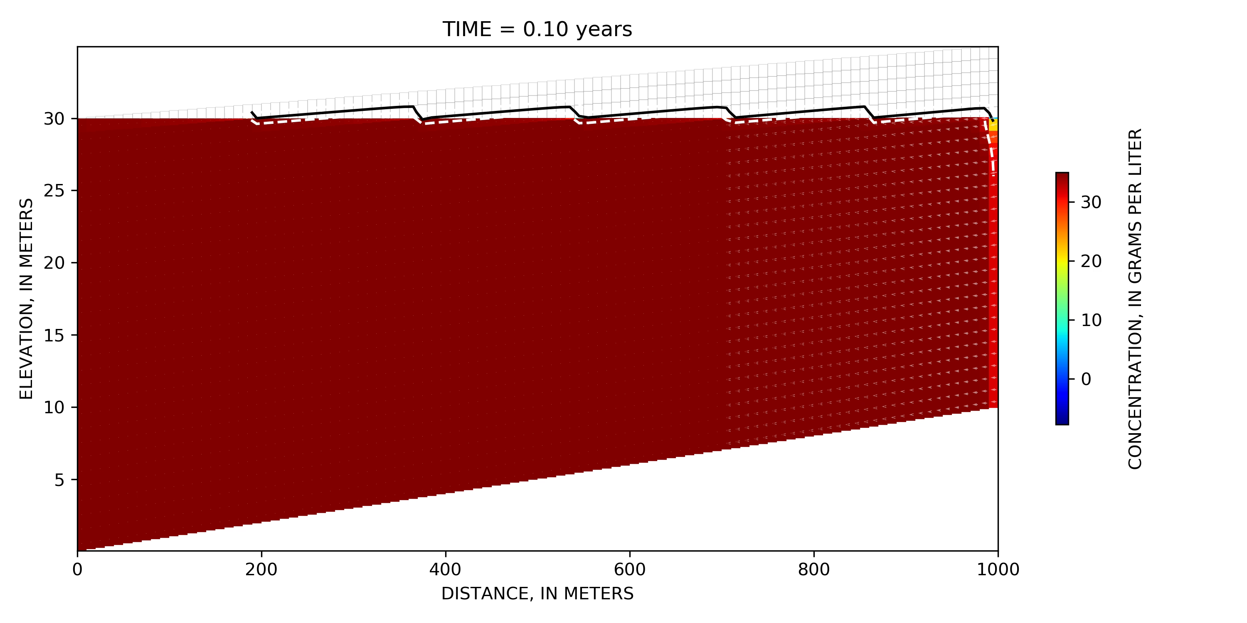
Spin-Up Simulation

Slide 22
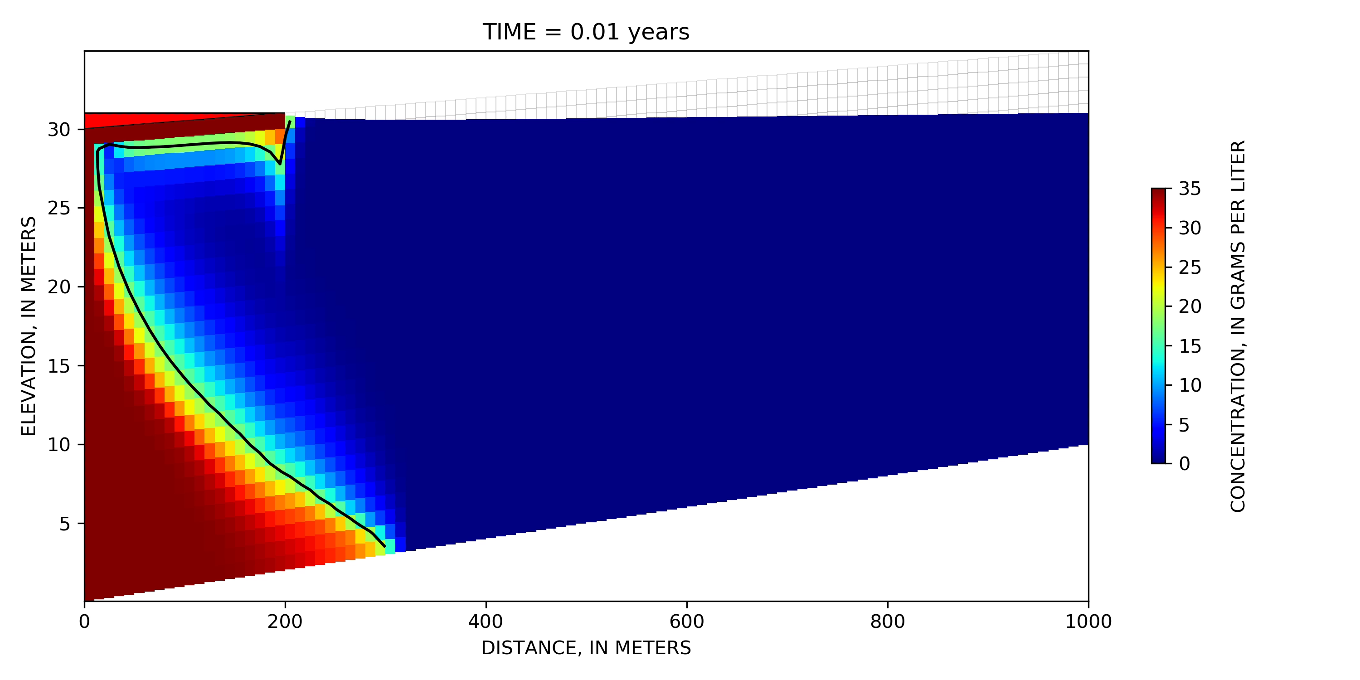
Instantaneous SLR 1 m / 100 years

Slide 23
Sea-Level Rise Boundary Conditions
s_{T}
f_{s} = s_{x}/s_{T}
s_{x}
recharge
recharge
recharge
R=R₀*(1-f_{s})
recharge
general-head boundary (C=C₀*f_{s})
general-head boundary

Slide 24
Sea-Level Rise Boundary Conditions
s_{T}
f_{s} = s_{x}/s_{T}
s_{x}
recharge
R=R₀*(1-f_{s})
recharge
general-head boundary
general-head boundary
general-head boundary (C=C₀*f_{s})
general-head boundary

Slide 25
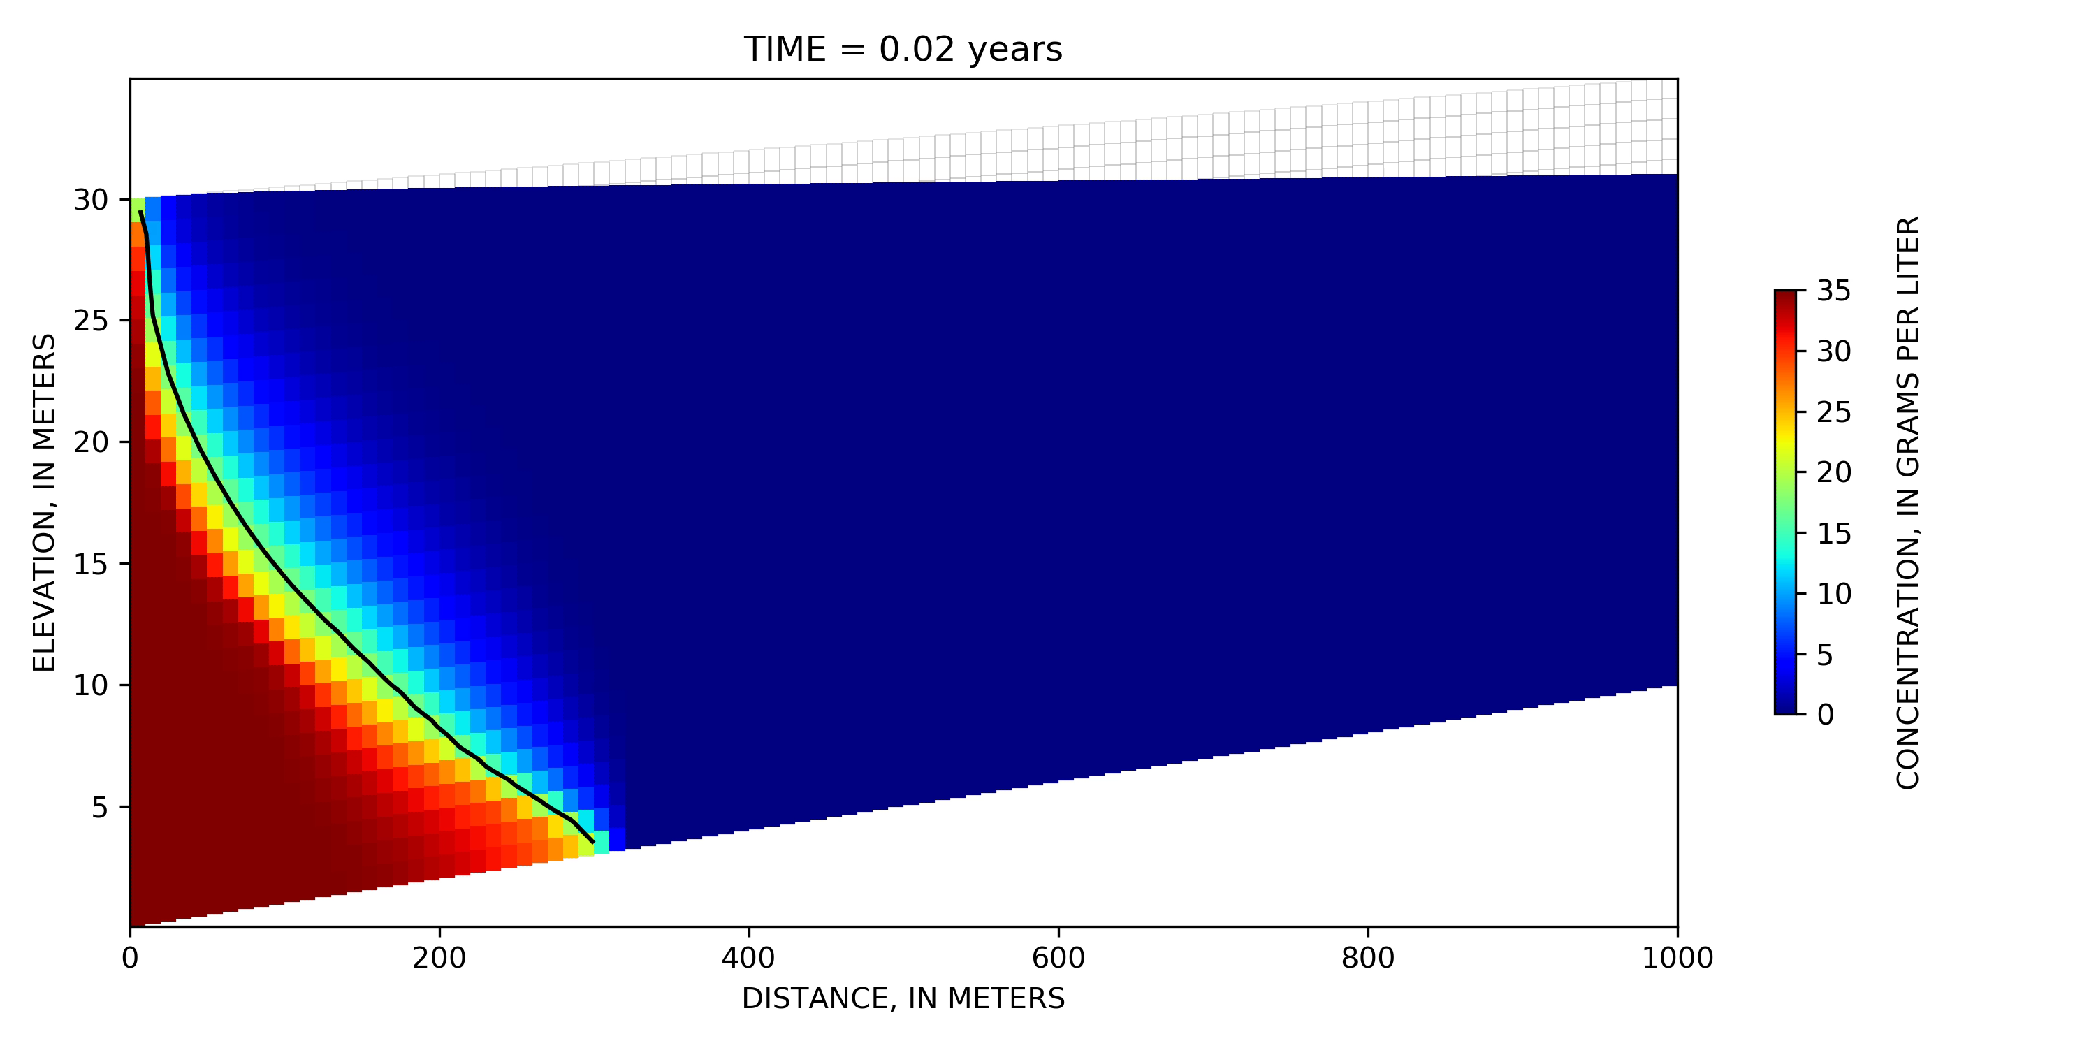
Gradual SLR 1 m / 100 years

Slide 26
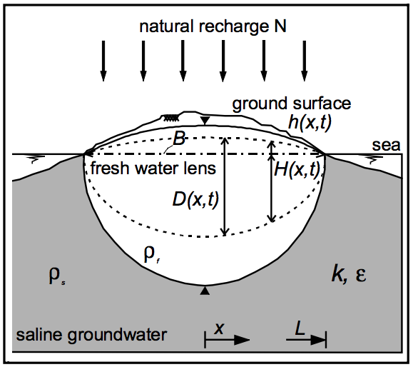
Island Simulation

Slide 27
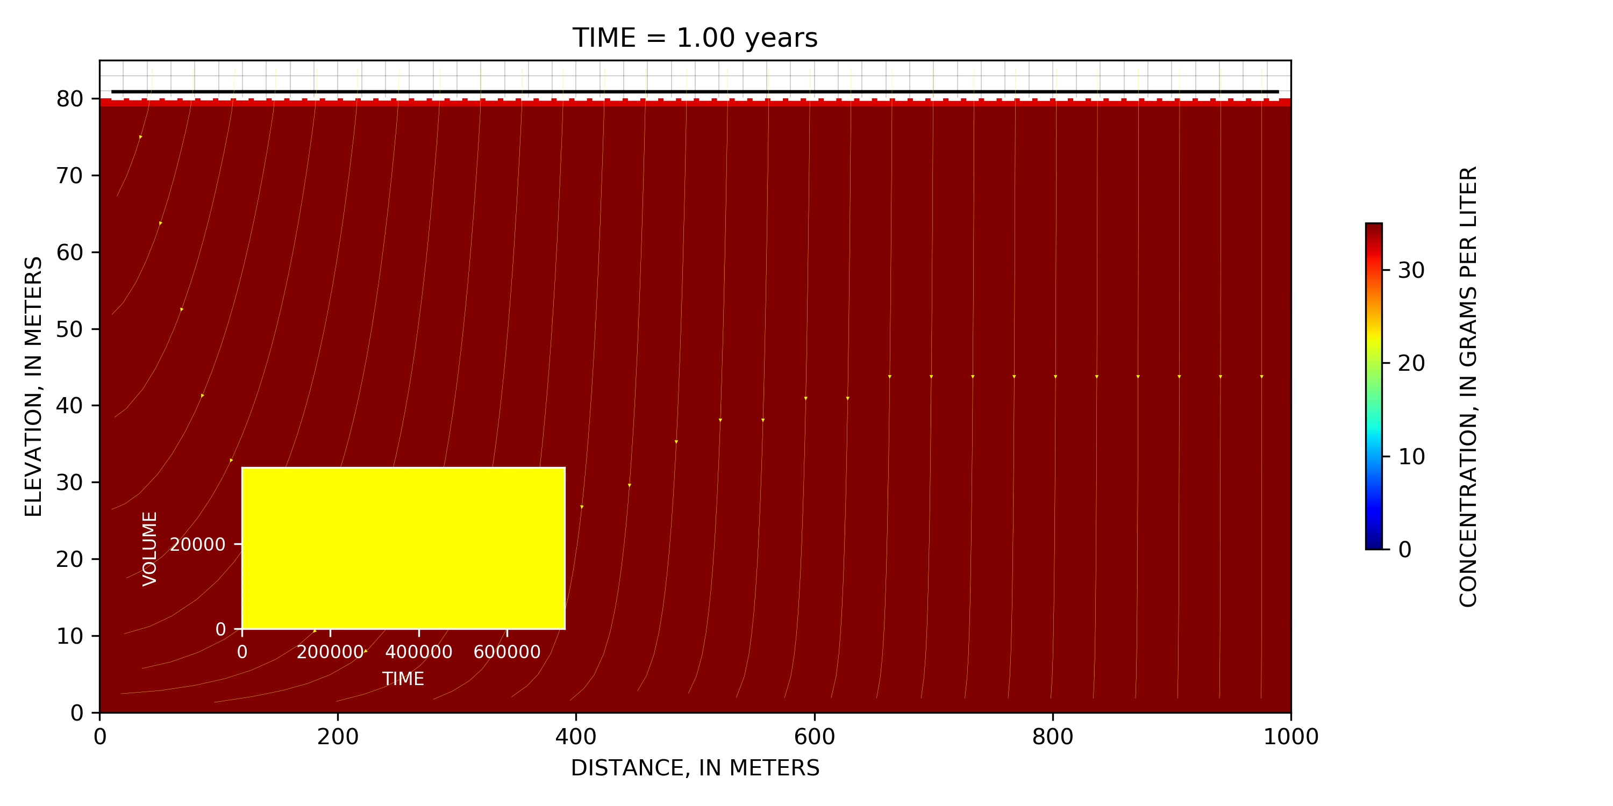
Spin-Up Simulation

Slide 28
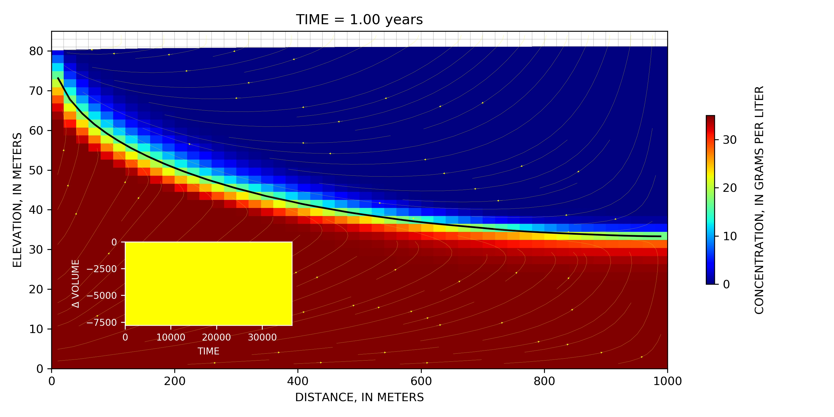
Gradual SLR 1 m / 100 years

Slide 29
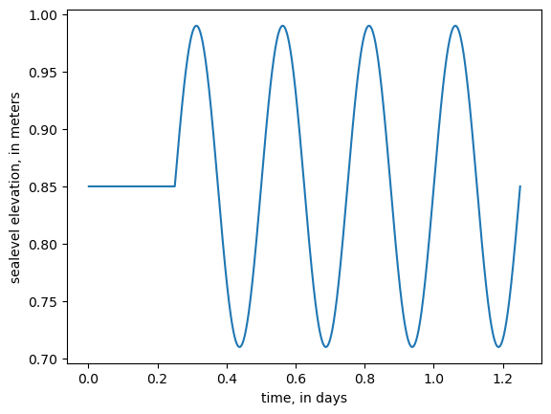
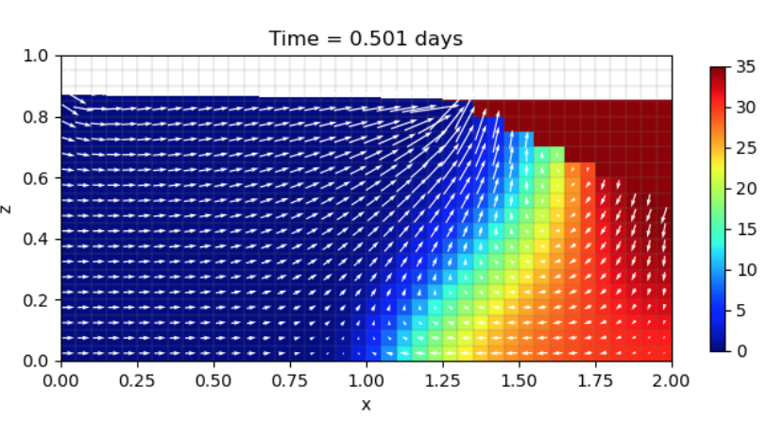
Example with FloPy
Simulate classic Henry saltwater intrusion problem
Use Newton formulation for stable wetting and drying
Include tidally varying sea-level boundary condition
Visualize results
Notes:
We are now going to switch over to a jupyter notebook and create a simple saltwater intrusion simulation based on the classic Henry problem. For this simulation, we have freshwater flowing into the box on the left side and a sloping seawater boundary on the right side. For this variation of the Henry problem, the seawater boundary has a sinusoidal variation to replicate the effect of tides.

